Slide 1

Trees
Presented by:
Elizer Ponio Jr.
Department of Computer Science
College of Computing and Information Technologies

Slide 2
What is a Tree?
A tree is a nonlinear hierarchical data structure that consists of nodes connected by edges.
Notes:
Have you asked yourself the question, why do people organize?
Lets go to the psychology of organizing
This predictability applies within the context of our homes, manifesting through the concept of organization

Slide 3
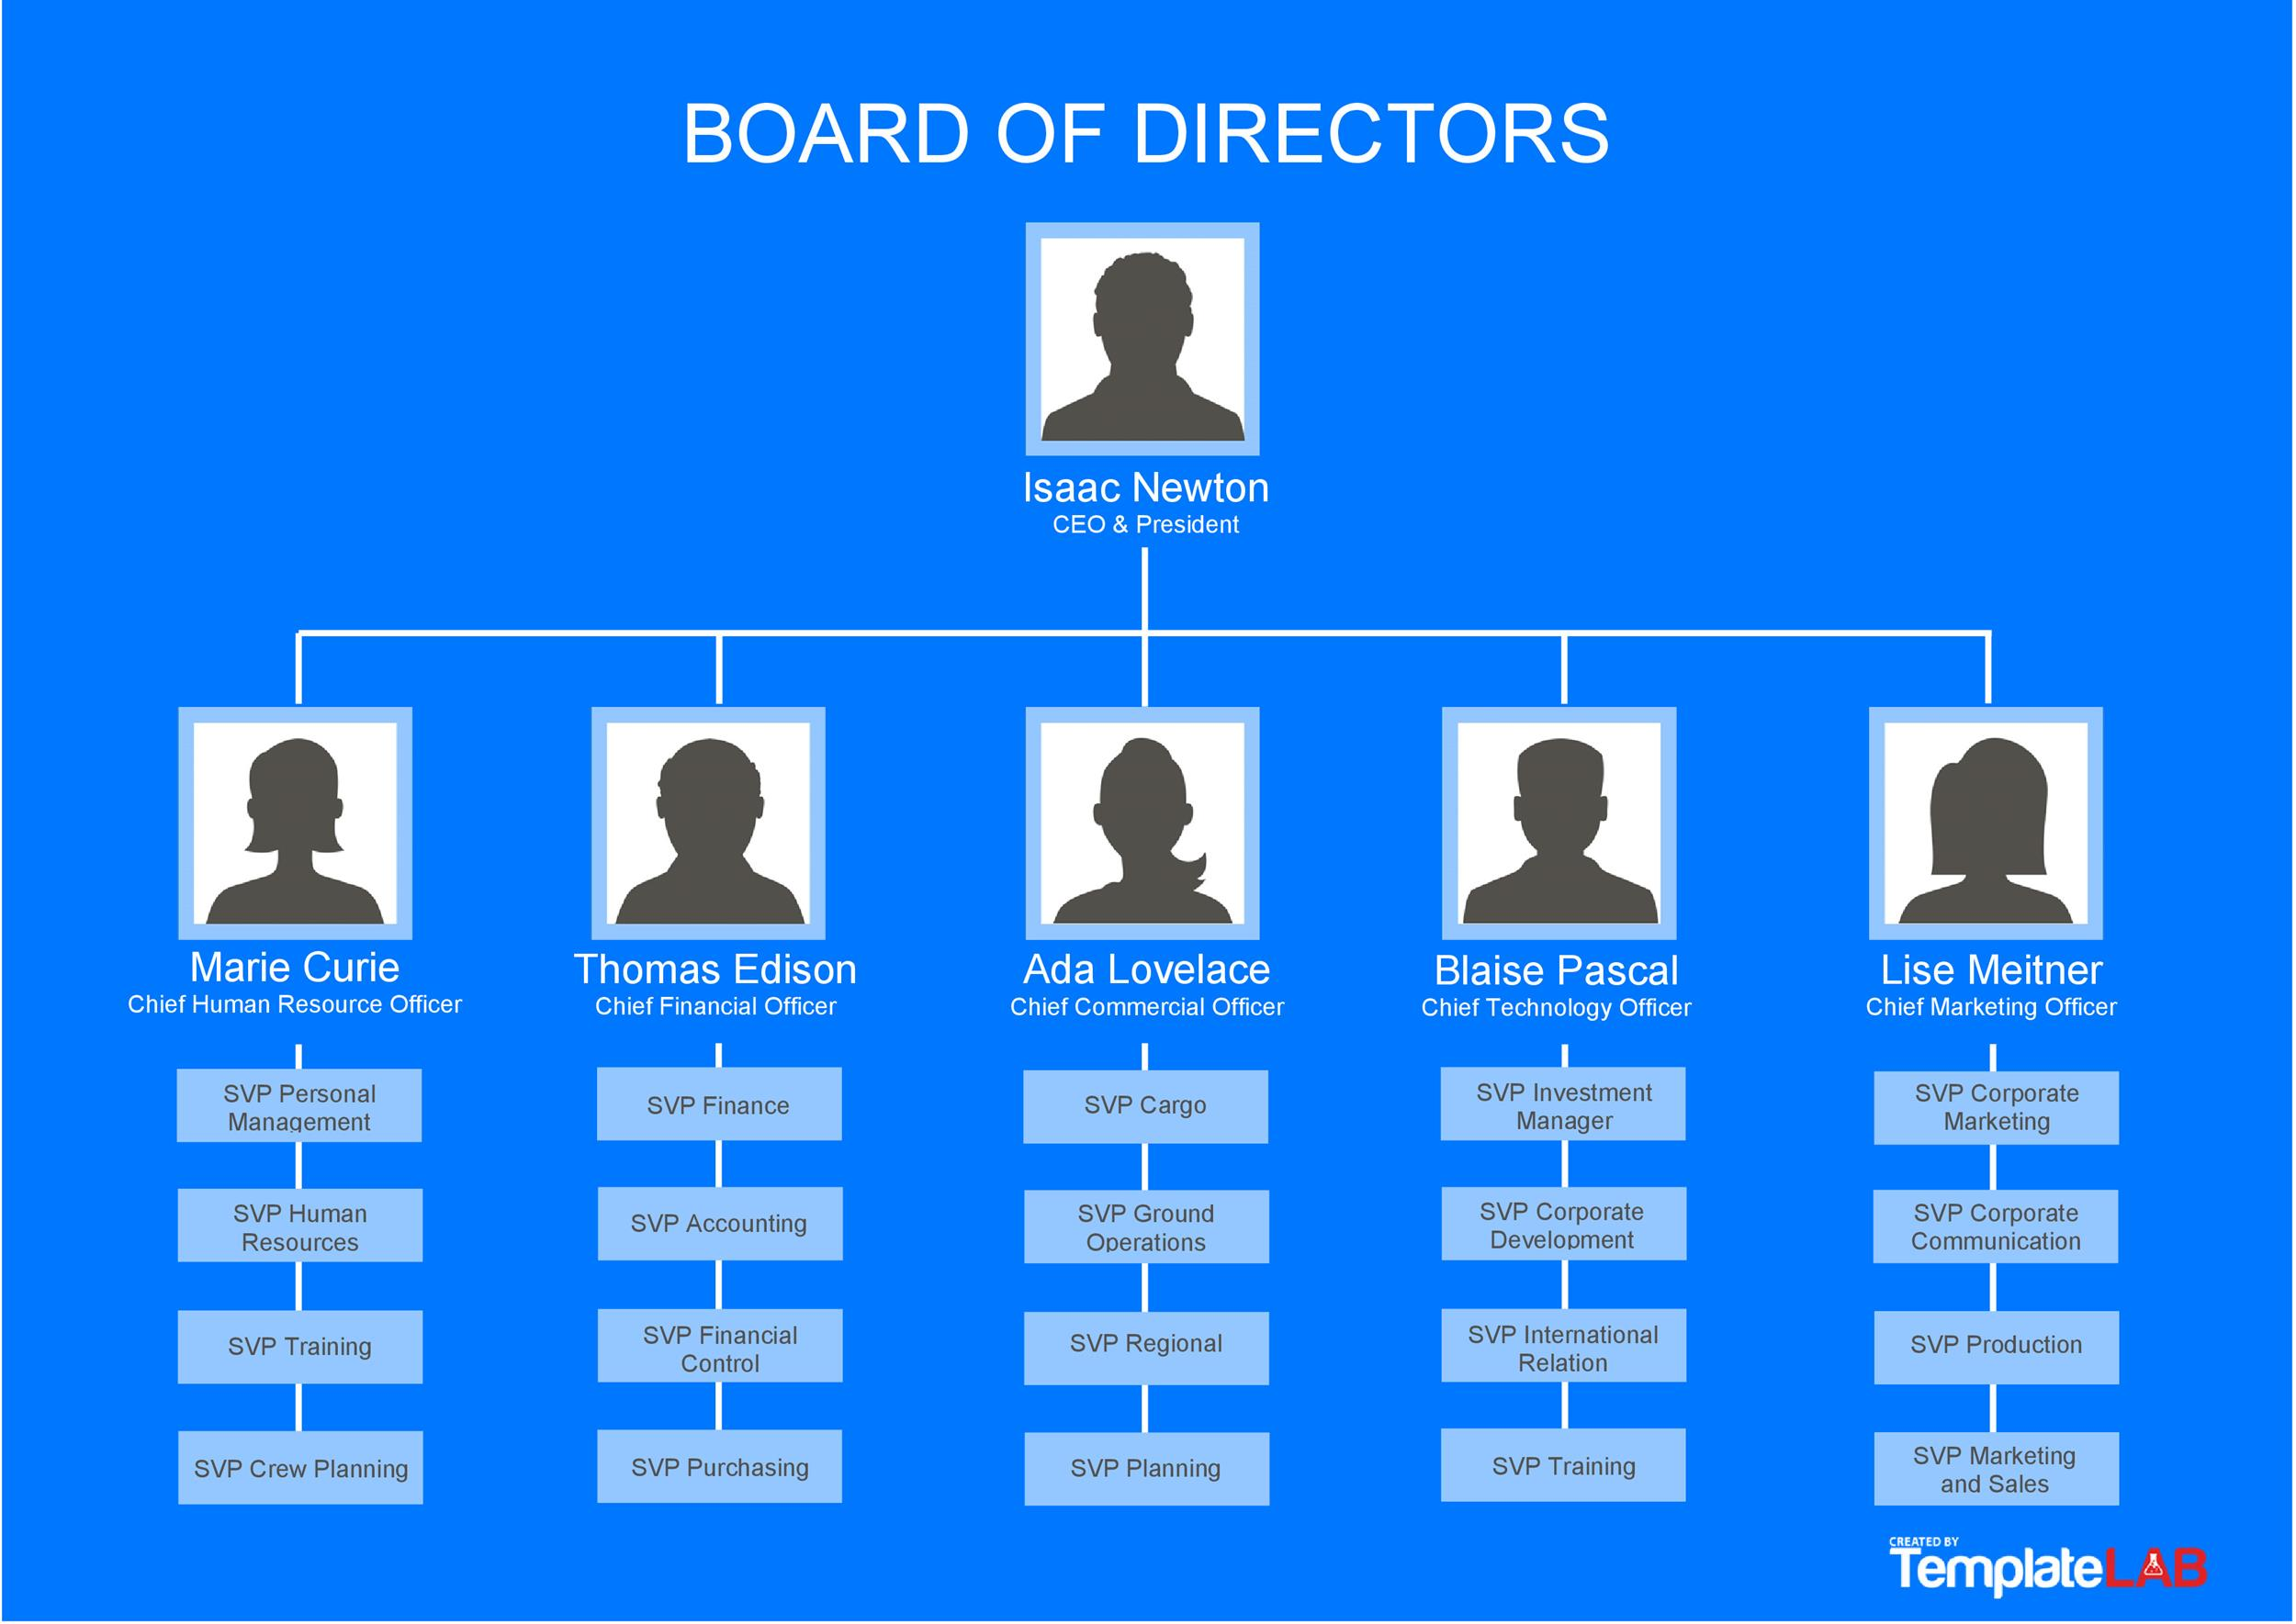
What is a Tree?
Notes:
Have you asked yourself the question, why do people organize?
Lets go to the psychology of organizing
This predictability applies within the context of our homes, manifesting through the concept of organization

Slide 4
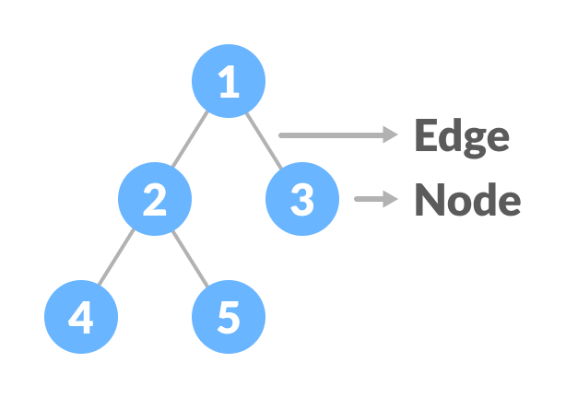
What is a Tree?
Notes:
Have you asked yourself the question, why do people organize?
Lets go to the psychology of organizing
This predictability applies within the context of our homes, manifesting through the concept of organization

Slide 5
Terminologies
Node
Edge
Root
Notes:
Have you asked yourself the question, why do people organize?
Lets go to the psychology of organizing
This predictability applies within the context of our homes, manifesting through the concept of organization

Slide 6
Terminologies
Parent
Child
Sibling
Notes:
Have you asked yourself the question, why do people organize?
Lets go to the psychology of organizing
This predictability applies within the context of our homes, manifesting through the concept of organization

Slide 7
Terminologies
Levels
Leaf
Subtree
Notes:
Have you asked yourself the question, why do people organize?
Lets go to the psychology of organizing
This predictability applies within the context of our homes, manifesting through the concept of organization

Slide 8
Node
The elements that makes up the tree.
Notes:
Have you asked yourself the question, why do people organize?
Lets go to the psychology of organizing
This predictability applies within the context of our homes, manifesting through the concept of organization

Slide 9
Edge
The connection between two nodes.
Notes:
Have you asked yourself the question, why do people organize?
Lets go to the psychology of organizing
This predictability applies within the context of our homes, manifesting through the concept of organization

Slide 10
Node
A
Edge
Edge
Node
B
C
Node
Edge
Edge
Edge
Edge
Node
D
E
Node
F
Node
G
Edge
Edge
Node
H
I
Node
Notes:
Have you asked yourself the question, why do people organize?
Lets go to the psychology of organizing
This predictability applies within the context of our homes, manifesting through the concept of organization

Slide 11
Root
It is the node at the top of a tree.
Notes:
Have you asked yourself the question, why do people organize?
Lets go to the psychology of organizing
This predictability applies within the context of our homes, manifesting through the concept of organization

Slide 12
Parent
A node except the root node that has one edge down to another node.
Notes:
Have you asked yourself the question, why do people organize?
Lets go to the psychology of organizing
This predictability applies within the context of our homes, manifesting through the concept of organization

Slide 13
Child
A node that has one edge up to another node.
Notes:
Have you asked yourself the question, why do people organize?
Lets go to the psychology of organizing
This predictability applies within the context of our homes, manifesting through the concept of organization

Slide 14
Siblings
Two or more nodes that have the same parent node.
Notes:
Have you asked yourself the question, why do people organize?
Lets go to the psychology of organizing
This predictability applies within the context of our homes, manifesting through the concept of organization

Slide 15
Leaf
A node without any child nodes.
Notes:
Have you asked yourself the question, why do people organize?
Lets go to the psychology of organizing
This predictability applies within the context of our homes, manifesting through the concept of organization

Slide 16
Levels
Level of a node represents the generation of a node. If the root node is at level 0, then its next child node is at level 1, its grandchild is at level 2, and so on.
Notes:
Have you asked yourself the question, why do people organize?
Lets go to the psychology of organizing
This predictability applies within the context of our homes, manifesting through the concept of organization

Slide 17
Root
A
Level 0
Parent Node
B
C
Level 1
Child Node
D
E
Leaf Node
F
Siblings
G
Level 2
H
I
Level 3
Notes:
Have you asked yourself the question, why do people organize?
Lets go to the psychology of organizing
This predictability applies within the context of our homes, manifesting through the concept of organization

Slide 18
Subtree
Any node of the tree along with its child nodes.
Notes:
Have you asked yourself the question, why do people organize?
Lets go to the psychology of organizing
This predictability applies within the context of our homes, manifesting through the concept of organization

Slide 19
A
B
C
D
E
F
G
Subtree
H
I
Subtree
Subtree
Notes:
Have you asked yourself the question, why do people organize?
Lets go to the psychology of organizing
This predictability applies within the context of our homes, manifesting through the concept of organization

Slide 20
Properties of a Tree
Number of edges of the tree
Height of the tree
Height of a node
Depth of a node
Degree of a node
Notes:
Have you asked yourself the question, why do people organize?
Lets go to the psychology of organizing
This predictability applies within the context of our homes, manifesting through the concept of organization

Slide 21
Number of edges of a tree
If a tree has N nodes then it will have (N-1) edges
Notes:
Have you asked yourself the question, why do people organize?
Lets go to the psychology of organizing
This predictability applies within the context of our homes, manifesting through the concept of organization

Slide 22
Number of edges of a tree
A
B
C
D
E
F
G
H
I
Number of nodes = 9
Number of edges = 9 – 1 = 8
Notes:
Have you asked yourself the question, why do people organize?
Lets go to the psychology of organizing
This predictability applies within the context of our homes, manifesting through the concept of organization

Slide 23
Height of the tree
The length of the longest path from the root node of the tree to a leaf node of the tree.
Count starts at zero
Notes:
Have you asked yourself the question, why do people organize?
Lets go to the psychology of organizing
This predictability applies within the context of our homes, manifesting through the concept of organization

Slide 24
Height of the tree
A
B
C
D
E
F
G
H
I
Height of the tree = 3
Notes:
Have you asked yourself the question, why do people organize?
Lets go to the psychology of organizing
This predictability applies within the context of our homes, manifesting through the concept of organization

Slide 25
Height of a node
The number of edges from the node to the deepest leaf
Count starts at zero
Notes:
Have you asked yourself the question, why do people organize?
Lets go to the psychology of organizing
This predictability applies within the context of our homes, manifesting through the concept of organization

Slide 26
Height of a node
A
B
C
Height of node B = 2
D
E
F
G
H
I
Notes:
Have you asked yourself the question, why do people organize?
Lets go to the psychology of organizing
This predictability applies within the context of our homes, manifesting through the concept of organization

Slide 27
Height of a node
A
B
C
Height of node D = 1
D
E
F
G
H
I
Notes:
Have you asked yourself the question, why do people organize?
Lets go to the psychology of organizing
This predictability applies within the context of our homes, manifesting through the concept of organization

Slide 28
Height of a node
A
B
C
D
E
F
G
H
I
Height of the node H = 0
Notes:
Have you asked yourself the question, why do people organize?
Lets go to the psychology of organizing
This predictability applies within the context of our homes, manifesting through the concept of organization

Slide 29
Height of a node
A
B
C
D
E
F
G
H
I
Height of nodes E, C , F, G = 0
Notes:
Have you asked yourself the question, why do people organize?
Lets go to the psychology of organizing
This predictability applies within the context of our homes, manifesting through the concept of organization

Slide 30
Depth of a node
The number of edges from the root to the node.
Count starts at zero
Notes:
Have you asked yourself the question, why do people organize?
Lets go to the psychology of organizing
This predictability applies within the context of our homes, manifesting through the concept of organization

Slide 31
Depth of a node
A
B
C
D
E
F
G
H
I
Depth of node H = 3
Notes:
Have you asked yourself the question, why do people organize?
Lets go to the psychology of organizing
This predictability applies within the context of our homes, manifesting through the concept of organization

Slide 32
Depth of a node
A
B
C
D
E
F
G
Depth of node D = 2
H
I
Notes:
Have you asked yourself the question, why do people organize?
Lets go to the psychology of organizing
This predictability applies within the context of our homes, manifesting through the concept of organization

Slide 33
Depth of a node
A
B
C
D
E
F
G
Depth of node E = 2
H
I
Notes:
Have you asked yourself the question, why do people organize?
Lets go to the psychology of organizing
This predictability applies within the context of our homes, manifesting through the concept of organization

Slide 34
Depth of a node
A
Depth of node B = 1
B
C
D
E
F
G
H
I
Notes:
Have you asked yourself the question, why do people organize?
Lets go to the psychology of organizing
This predictability applies within the context of our homes, manifesting through the concept of organization

Slide 35
Depth of a node
Depth of node A = 0
A
B
C
D
E
F
G
H
I
Notes:
Have you asked yourself the question, why do people organize?
Lets go to the psychology of organizing
This predictability applies within the context of our homes, manifesting through the concept of organization

Slide 36
Depth of a node
A
B
C
Depth of node C = 1
D
E
F
G
H
I
Notes:
Have you asked yourself the question, why do people organize?
Lets go to the psychology of organizing
This predictability applies within the context of our homes, manifesting through the concept of organization

Slide 37
Depth of a node
A
B
C
D
E
F
G
Depth of node F = 2
H
I
Notes:
Have you asked yourself the question, why do people organize?
Lets go to the psychology of organizing
This predictability applies within the context of our homes, manifesting through the concept of organization

Slide 38
Depth of a node
A
B
C
D
E
F
G
Depth of node G = 2
H
I
Notes:
Have you asked yourself the question, why do people organize?
Lets go to the psychology of organizing
This predictability applies within the context of our homes, manifesting through the concept of organization

Slide 39
Node Height and Depth
Height = 3
Depth = 0
A
Height = 2
Depth = 1
B
C
Height = 0
Depth = 1
Height = 1 Depth = 2
D
E
Height = 0 Depth = 2
F
Height = 0
Depth = 2
G
Height = 0
Depth = 2
Height = 0
Depth = 3
H
I
Height = 0
Depth = 3
Notes:
Have you asked yourself the question, why do people organize?
Lets go to the psychology of organizing
This predictability applies within the context of our homes, manifesting through the concept of organization

Slide 40
Degree of a node
The number of child nodes of a node.
Notes:
Have you asked yourself the question, why do people organize?
Lets go to the psychology of organizing
This predictability applies within the context of our homes, manifesting through the concept of organization

Slide 41
Degree of a node
A
Degree of node A = 2
B
C
D
E
F
G
H
I
Notes:
Have you asked yourself the question, why do people organize?
Lets go to the psychology of organizing
This predictability applies within the context of our homes, manifesting through the concept of organization

Slide 42
Degree of a node
A
Degree of node B = 2
B
C
D
E
F
G
H
I
Notes:
Have you asked yourself the question, why do people organize?
Lets go to the psychology of organizing
This predictability applies within the context of our homes, manifesting through the concept of organization

Slide 43
Degree of a node
A
B
C
Degree of node D = 2
D
E
F
G
H
I
Notes:
Have you asked yourself the question, why do people organize?
Lets go to the psychology of organizing
This predictability applies within the context of our homes, manifesting through the concept of organization

Slide 44
Degree of a node
A
B
C
Degree of node C = 2
D
E
F
G
H
I
Notes:
Have you asked yourself the question, why do people organize?
Lets go to the psychology of organizing
This predictability applies within the context of our homes, manifesting through the concept of organization

Slide 45
Degree of a node
A
B
C
D
E
F
G
H
I
Degree of nodes H, I ,E F, G = 0
Notes:
Have you asked yourself the question, why do people organize?
Lets go to the psychology of organizing
This predictability applies within the context of our homes, manifesting through the concept of organization

